Slide 1
Text-to-Speech VOICE CLONING
2010030090 Madhu Sai
2010039002 Jashwanth Reddy
2010030343 Simon Sumanth
2010039004 Mitesh Chandra

Slide 2
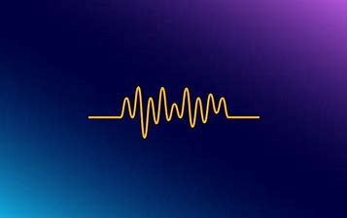
OUTLINE:
Introduction
Literature review
Objectives
Problems in existing system
Implementation Stages
Methodology
Conclusion

Slide 3
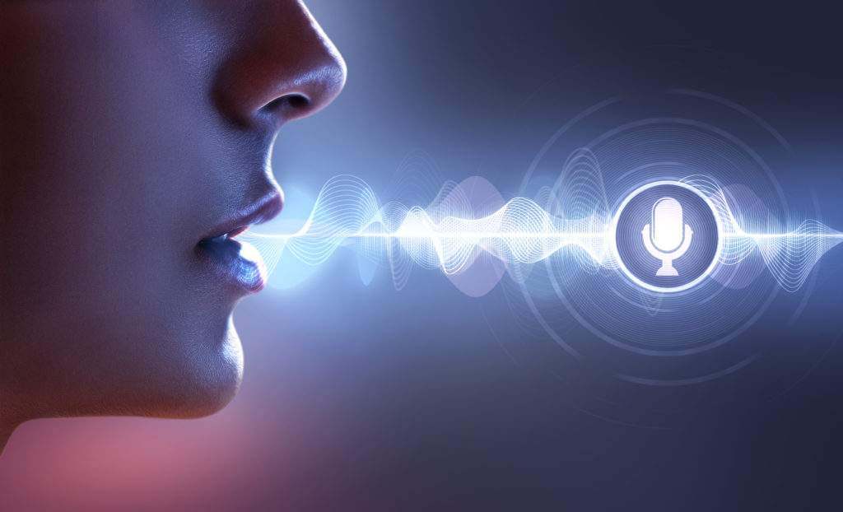
Introduction
Voice cloning is the process in which one uses a computer to generate the speech of a real individual, creating a clone of their specific, unique voice using artificial intelligence (AI).
Text-to-speech (TTS) systems, which can take written language and transform it into spoken communication, is not to be confused with voice cloning. TTS systems are much more limited from the outputs they produce compared to voice cloning technology, which is really more of a custom process.

Slide 4
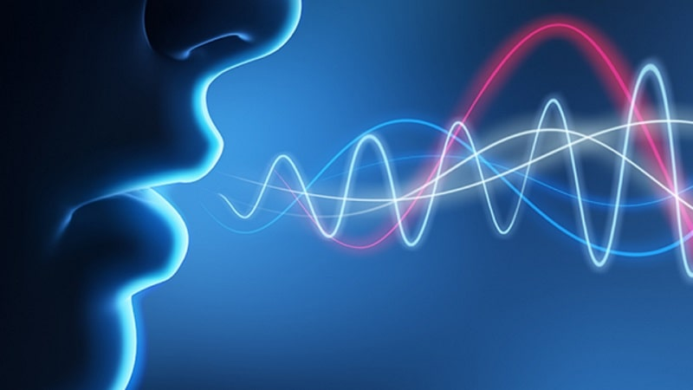
Literature Review
https://www.veritone.com/blog/what-is-voice-cloning-and-how-does-it-work/
https://elib.uni-stuttgart.de/bitstream/11682/11721/1/Bhattacharjee_Master_Thesis.pdf
We study two approaches: speaker adaptation and speaker encoding.
Speaker adaptation is based on fine-tuning a multi-speaker generative model.
Speaker encoding is based on training a separate model to directly infer a new speaker embedding, which will be applied to a multi-speaker generative model.

Slide 5
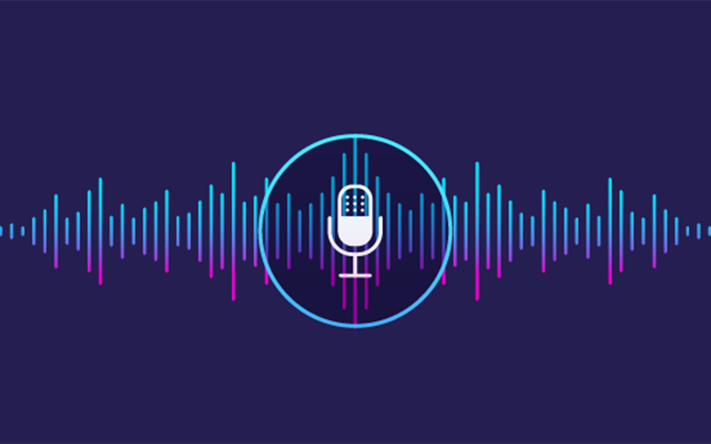
Objectives
The objective of this project is first, we would like to explore different deep learning techniques for voice cloning. As a final goal, we would like to develop a suitable voice cloning algorithm, which takes only a few seconds of reference speech and generates natural-sounding audio samples. The algorithm should be able to generate speech audio in the voice of different speakers, including those unseen during training, that is, in a zero-shot setting

Slide 6
Problems in existing system
In the existing model it takes more time to train the neural model with a specific voice.
The process is slow and outcome is also as well.
For the existing model the input voice given should be long so that the voice can be recognized.

Slide 7
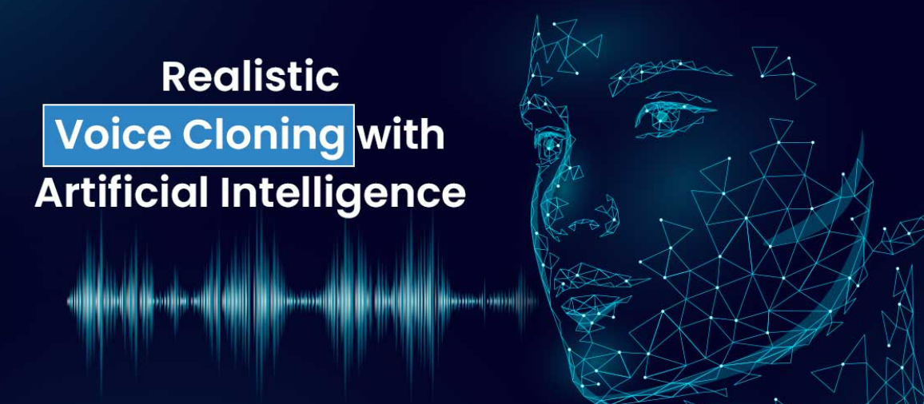
Implementation Steps
Firstly we consider the reference waveform.
Then the speaker encoder does the embedding work.
The synthesizer accepts the voice inputs and synthesises the voice.
The mel spectrogram converts the synthesized voice into a graph format.
The vocoder reduces the frequency bandwidth.
Then the output will be in our desired voice.

Slide 8
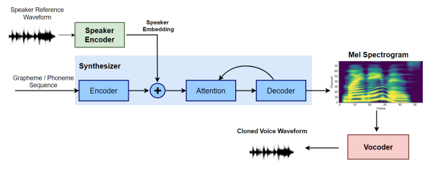
Methodology
Speaker Encoder Network: The speaker encoder network’s job is to take audio of a given speaker as input, and encode the characteristics of their voice into a low dimensional vector embedding. It does not care about what the speaker is saying, all it cares about is how a speaker is saying something.
Synthesis Network: It is a Seq2Seq neural network based on google’s Tacotron 2 that generates a Mel spectrogram from the text, conditioned on the speaker embedding.
Vocoder Network: The vocoder takes the Mel spectrograms generated by the synthesis network as input and autoregressively generate the time-domain audio waveforms as output.

Slide 9
Methodology
Tools :
Librosa
Librosa is a Python package that can be used to analyze audio and music. It contains the fundamental components required to construct information retrieval systems for music.
Audacity
Audacity is a free and open-source digital audio recording and editing program compatible with most operating systems. We utilized Audacity to collect and extract audio samples of popular personalities from YouTube videos along with some of the spectrogram visualizations of synthesized audios.
React
React is a free, open-source front-end JavaScript library for building User Interface components for web applications

Slide 10
Conclusion
The primary focus is to achieve voice cloning with a short reference speech signal of the target speaker.
The primary focus is to achieve voice cloning in a Zero-shot setting with a short reference speech signal of the target speaker.
References
[1] https://towardsdatascience.com/wavenet-google-assistants-voice-synthesizer-a168e9af13b1
[2] https://deepmind.com/blog/article/wavenet-generative-model-raw-audio
[3] https://arxiv.org/abs/1609.03499
[4] https://arxiv.org/abs/1702.07825
[5] https://arxiv.org/abs/1710.07654
[6] https://papers.nips.cc/paper/7700-transfer-learning-from-speaker-verification-to-multispeaker-text-to-speech-synthesis

Slide 11

Thank you

